Slide 1
4. Search Engine Analytics
Amit Aylani

Slide 2
Contents
Types of Search Engines
Search Engine Analytics
Search Engine Analytics Tools

Slide 3
Search Engines
Search engines are tools that help users find information on the internet. They do this by searching for information that corresponds to a user's request (e.g., keywords).
There are billions of websites on the internet, so search engines are crucial for helping users find the right information quickly.
There are different types of search engines.

Slide 4
Types of Search Engine
1) Crawler-based,
2) Directories
3) Metasearch engines.

Slide 5
Crawler based Search Engine
Crawler-based search engines create their databases or lists automatically, without any human intervention.
E.g. google, bing
Web crawling involves collecting and storing information about web pages
Indexing involves categorizing and storing this data in a database for quick access
Searching involves using keywords to query the index and provide a list of relevant web pages ranked according to various factors

Slide 6
Directories
Directory listings are compiled and created by human editors
Website owners can submit their website for inclusion in the directory
The submission is reviewed by the editor before being added to the directory
Some examples of human-created directories include Yahoo Directory, Open Directory, and LookSmart.

Slide 7
Meta Search
Metasearch engines compile and display results from multiple individual search engines . e.g. Metacrawler,Mamma, and Dogpile
Local search engines are embedded within a specific website and only search the content of that website
Global search engines search the entire web and can be localized to specific websites
Examples of global search engines include Google and Bing

Slide 8
Search Engine Analytics
Search engine analytics involves analyzing and interpreting data from search engines
It helps website owners understand and improve their website's performance in search results
It can involve analyzing various data points such as the number of visitors, keywords used, pages visited, and website position in search results
Search engine analytics can be used to track the effectiveness of SEO efforts and guide future SEO strategies
There are two types of Search Engine Analytics
1) Search engine optimization
2) Search engine trend analysis.

Slide 9
Search Engine Optimization
Search engine optimization (SEO) is the process of improving a website's ranking on a search engine results page (SERP)
SERPs have both organic and nonorganic results, with organic results being based on relevance to the user's query and nonorganic results being paid advertisements
It is important for websites, especially commercial ones, to have a high ranking on SERPs because it can lead to more traffic and potential customers
The main factor that determines a website's ranking on a SERP is its PageRank, which is determined by the quality and number of incoming links to the website
Tools like Open SEO Stats can be used to check a website's PageRank and other relevant information such as traffic, hyperlink status, and page speed.

Slide 10
Search Trends Analysis
How people search for your brand?
When does interest spike in your products or services?
Which keywords drive more traffic?
Which regions are interested in your brand?
What are trending topics over the Internet?
How are your competitors performing?

Slide 11
Search Trends Analysis
Search engine trend analytics involves analyzing and understanding the keywords used in search engines.
Google Trends is a comprehensive tool for analyzing search engine trends and predicting future trends.
It can be used to understand how people search for a particular brand, when interest in products or services spikes, which keywords drive the most traffic, and how a brand's competitors are performing.
Google Trends data has also been used in various industries to detect early warning signs and track flu epidemics.
From a business perspective, Google Trends can help answer questions about search trends and patterns related to a brand.
http://www.google.com/trends/

Slide 12
Search Engine Analytics Tools
Google Trends is a search engine analytics tool
Canopy is a multimedia analytics tool for deep investigation of large multimedia collections
Google Alerts is a content detection and notification service that alerts users when new content matching their search terms is found on the internet
Icerocket is a tool that specializes in blog searches and also captures activity on social media platforms
Social Mention is a tool similar to Google Alerts but focused on social media sites and allows users to focus on particular areas such as blogs
TweetBeep is a tool that allows users to receive daily search results via email for specific keywords on Twitter.

Slide 13
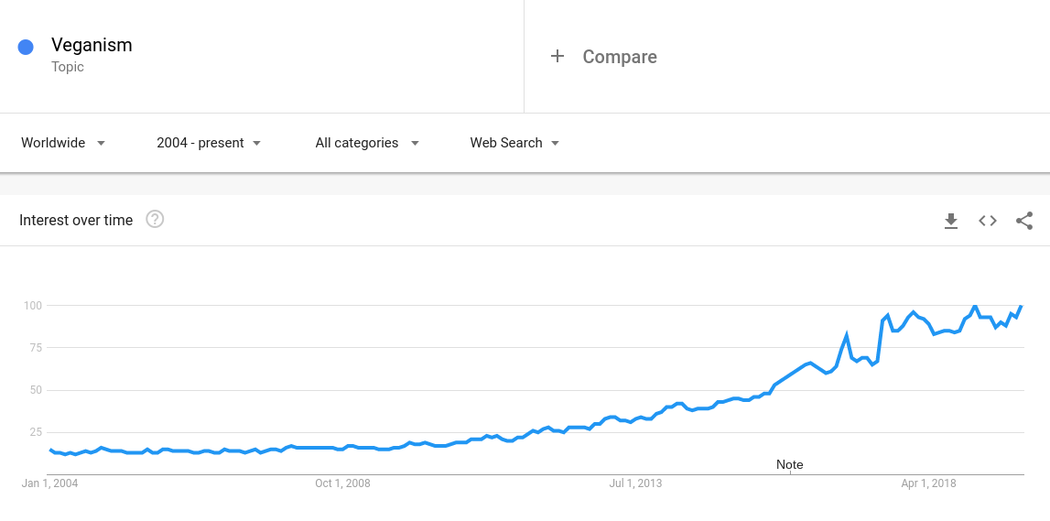

Slide 14
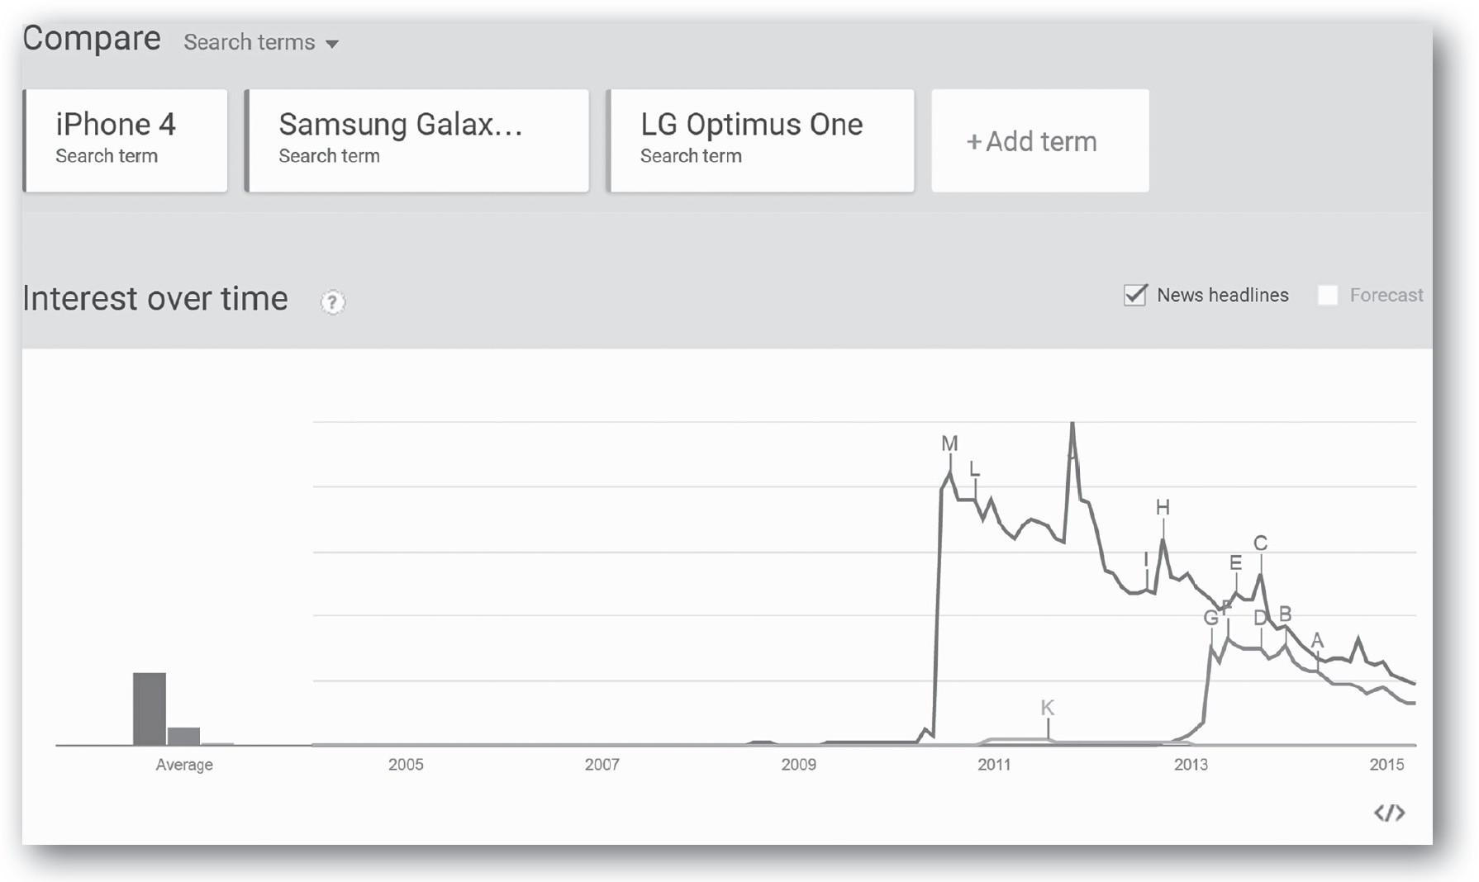
Google Trends

Slide 15
Type of Analytics Provided by Google Trends
Year in Search
Trending Searches
Trending on YouTube
Top Charts
Explore
Subscription

Slide 16
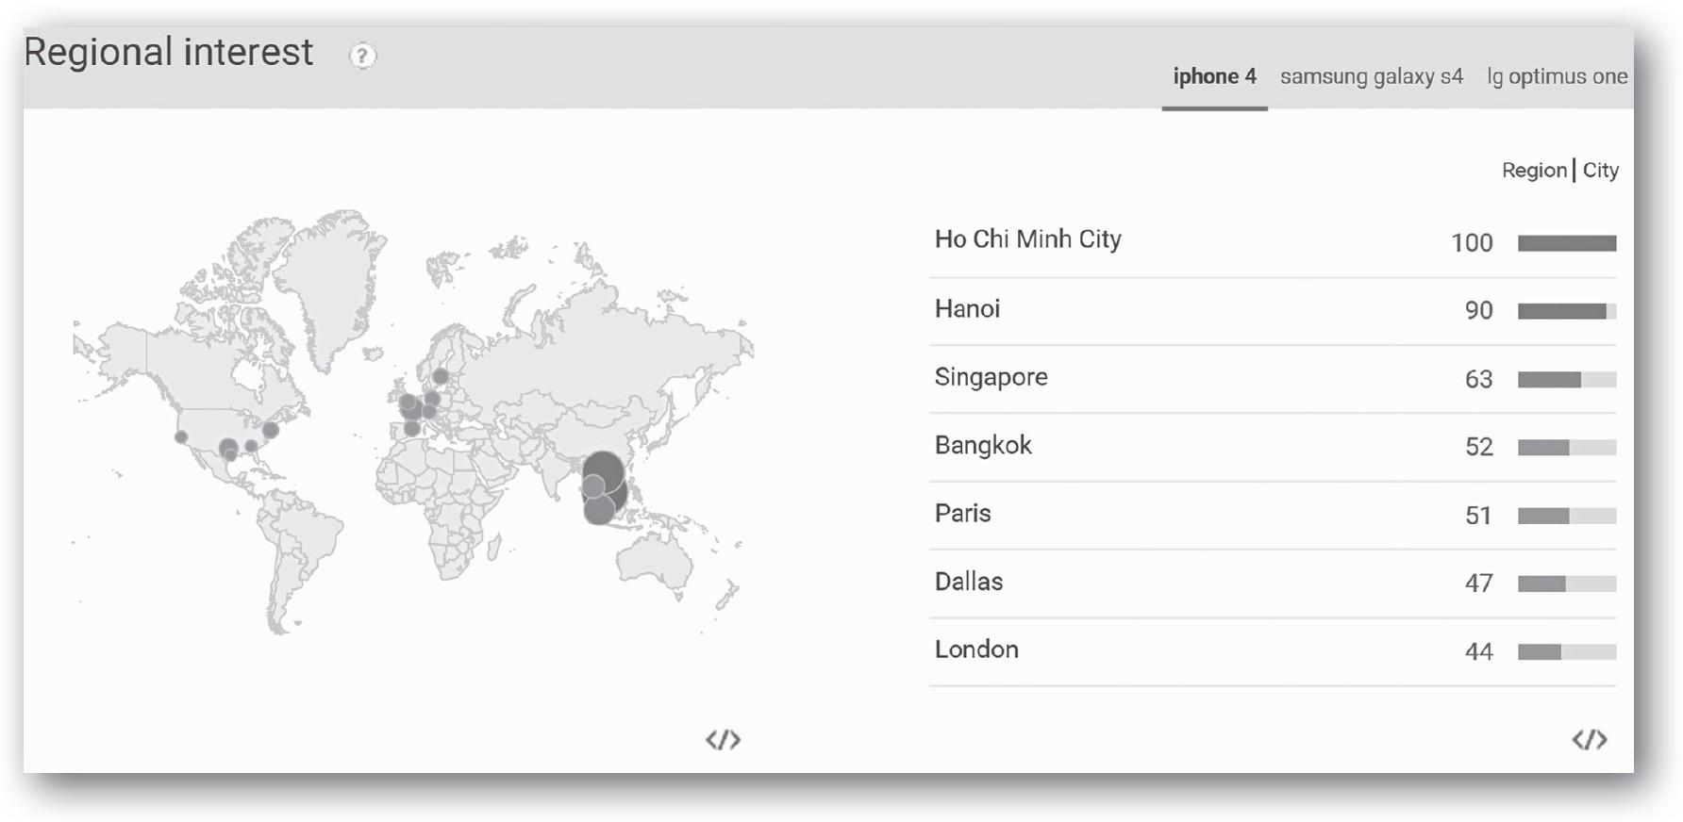
Regional Interest

Slide 17
Understanding the Research Function
Search Terms | The Results Displayed
Social media analytics | Results can include searches containing the terms “social,” “media,” and “analytics” in any order.
“Social media analytics” | Results will only include the exact search terms included inside of the quotation marks.
social + analytics | Results can include searches containing the words “social” OR “analytics.”
social – analytics | Results will include searches containing the word “social,” but will exclude searches containing the word “analytics.”

Slide 18
Grouping Search Term
Grouping Search Terms
Overall, you can search up to five groupings at one time, with up to twenty-five search terms in each grouping. Consider the following example.
iPhone 2 + Galaxy S2 + LG G (Grouping 1)
iPhone 3 + Galaxy S3 + LG Optimus F3 (Grouping 2)
iPhone 4 + Galaxy S4 (Grouping 3)
iPhone 5 + Galaxy S5 + LG Optimus F6 (Grouping 4)
iPhone 6+ Galaxy S6 (Grouping 5)

Slide 19
Customizing the Search
Google Trends allows users to customize search results by country, year, category, and type of web resource
Users can also select custom data ranges from the date dropdown menu
Trend data is only available from 2004 onwards.

Slide 20
Questions
What is the function of a search engine?
Explain different types of search engines.
Differentiate between local and global search engines.
What is search engine analytics?
Explain the two main categories of search engine analytics.
What is the purpose of search engine optimization?
What is the purpose of search engine trend analysis?

